Slide 1
The Art of Being a Decision Doula
Practical Ways to Help Your Customers Make Timely Decisions
terrienovak.com
© 2019 Concept Bridges, LLC
Notes:
Thank you for having me here today -

Slide 2
As a business owner, how many decisions do you make per day?
100?
1000?
10,000?
35,000
Where to commit your company’s limited resources
Which people to hire (which ones to let go)
What new ventures you should pursue (or not)
Terrie Novak
-Business Owner
-Business Systems Analyst
-Author
-Over two decades facilitating decisions
When overwhelmed or intimidated
no decisions get made no action gets taken
terrienovak.com
© 2019 Concept Bridges, LLC
Notes:
Questions at the end….
Decisions like these can weigh on you a lot more heavily. They can overwhelm and intimidate.
And when you feel like that, no decisions get made, and no action gets taken
My name is Terrie Novak. I’m a small business owner, just like you.
I’m also a business systems analyst. I’ve spent decades helping software development teams make the thousands of decisions needed to profitably deliver products to market.

Slide 3
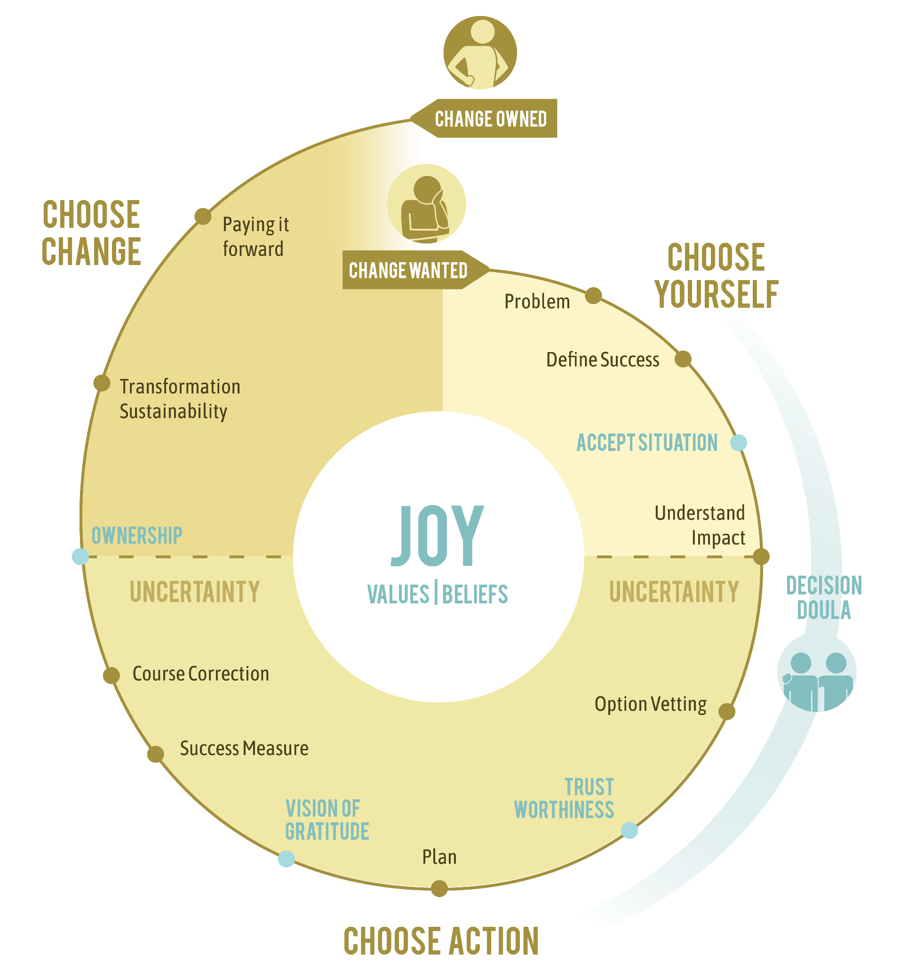
Why is decision making so agonizing?
It’s not one decision, it’s a series of choices that bring about change.
It’s a journey into uncertainty.
It’s easy to fall into the trap of thinking you’ll make the wrong decision.
Your customer is counting on you
to balance their brain’s response to uncertainty.
terrienovak.com
© 2019 Concept Bridges, LLC
Notes:
Decisions like these can weigh on you a lot more heavily. They can overwhelm and intimidate.
And when you feel like that, no decisions get made, and no action gets taken. That’s a certain recipe for trouble in your business… and, frankly, any area of your life.

Slide 4
Is there a litmus test for a good decision?
Addresses the problem
The impact is understood
Instills confidence
Complex decisions must include both critical and intuitive thinking.
Use a simple decision process.
terrienovak.com
© 2019 Concept Bridges, LLC
Notes:
Random falls short on confidence and impact (did OK on addressing the problem)

Slide 5
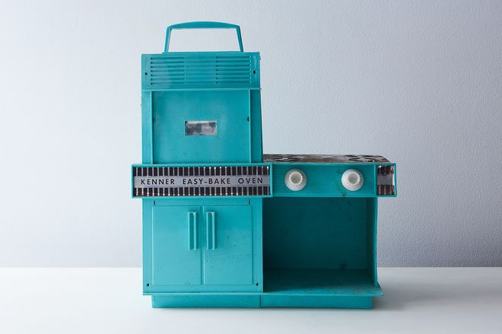
Why do I need a decision process?
SELF
ACTION
CHANGE
Preferences
Values/beliefs
Situation
Vet options
Trust
Measure
Plan
Sustainability
Pay it forward
Shifts brain from reaction
Mitigates cognitive bias
Commitment to action
Motivates a fair-minded attitude making it better for everyone.
terrienovak.com
© 2019 Concept Bridges, LLC
Notes:
Random falls short on confidence and impact (did OK on addressing the problem)

Slide 6
Your role as a decision doula
Doesn’t make the decisions
Is an advocate
Helps communicate preferences
Answers questions
Explains procedures & possible complications
Helps develop a plan
Helps you get into comfortable positions
Teaches how to care for your new life
Doula: a servant who assists before, during & after a transformation
terrienovak.com
© 2019 Concept Bridges, LLC

Slide 7
Practical Ways to Help Your Customer Make
Timely Decisions that Stick
Clearly communicate your values and beliefs via brand.
Customer is looking to align with
their preferences/values/beliefs
What’s your Credo, Corporate Story
Customer will look for evidence of honesty, competence, reliability in your
words & actions
2. Demonstrate you’re trustworthy.
Are you exaggerating? Overextending? Consistent?
3. Know what’s important to them & what’s involved in owning the results.
What will you see when this is wildly successful?
You want a customer with confidence and a sense of accountability for their choices
Encourage your customer to trust their inner wisdom.
terrienovak.com
© 2019 Concept Bridges, LLC
Notes:
Random falls short on confidence and impact (did OK on addressing the problem)

Slide 8
QUESTIONS?
Please fill out a feedback form
Pick up a book Decision Doctor (Powell’s purple room)
Get a coupon for upcoming online program Decision Dexterity
terrienovak.com
© 2019 Concept Bridges, LLC
Notes:
Traps
People define value differently
Everything is top value
Criteria doesn’t apply to all items in the same way
Instability and shift
Accept initial framing of the problem
Weight evidence that confirms existing impressions
5.3.6 Techniques
Backlog Management
Decision Analysis – identify high value requirements
Estimation
Financial Analysis – how timing of delivery affects value

